Slide 1

Grief and Bereavement

Slide 2
What is Grief?
Grief is felt when something or someone that you formed an emotional bond with is lost.
It can be experienced when anticipating a loss, when the loss occurs, to years after the loss occurred.
Grief is like a scar.
The idea that there are stages of grief that people move through is not as supported as it once was. Now there are many different concepts and theories about grief.
Grief is experienced and handled in different ways by different people.

Slide 3
Common types of Grief
Anticipatory Grief
Experienced before an expected loss, such as when a loved one has a terminal illness.
Ambiguous Loss
Occurs when the loss is unclear or unresolved, such as a missing person or a loved one with dementia, creating ongoing uncertainty and emotional strain
Normal (Uncomplicated) Grief
This is the typical response to loss, involving a range of emotional, physical, and social reactions. It usually lasts from six months to two years, though cultural and individual differences can extend this period
Complicated Grief
This type persists long-term and can interfere with daily functioning. It may be diagnosed as prolonged grief disorder, characterized by intense longing and preoccupation with the loss
Traumatic Grief
Occurs after sudden or unexpected losses, such as accidents or sudden death. It can be intense and disorienting, often requiring immediate emotional support

Slide 4
What is Bereavement?
Bereavement is the state of living without a loved one, from which you have been deprived usually, but not always, as a result of death.

Slide 5
Types of Loss
Sudden deaths to anticipated deaths
Terminal illness deaths
Suicides
Can also come from subsequent loss, like that of independence, health, relationships, and changes of roles
Anyone can experience these types of loss
Loss has a ripple effect that can impact a web of people

Slide 6
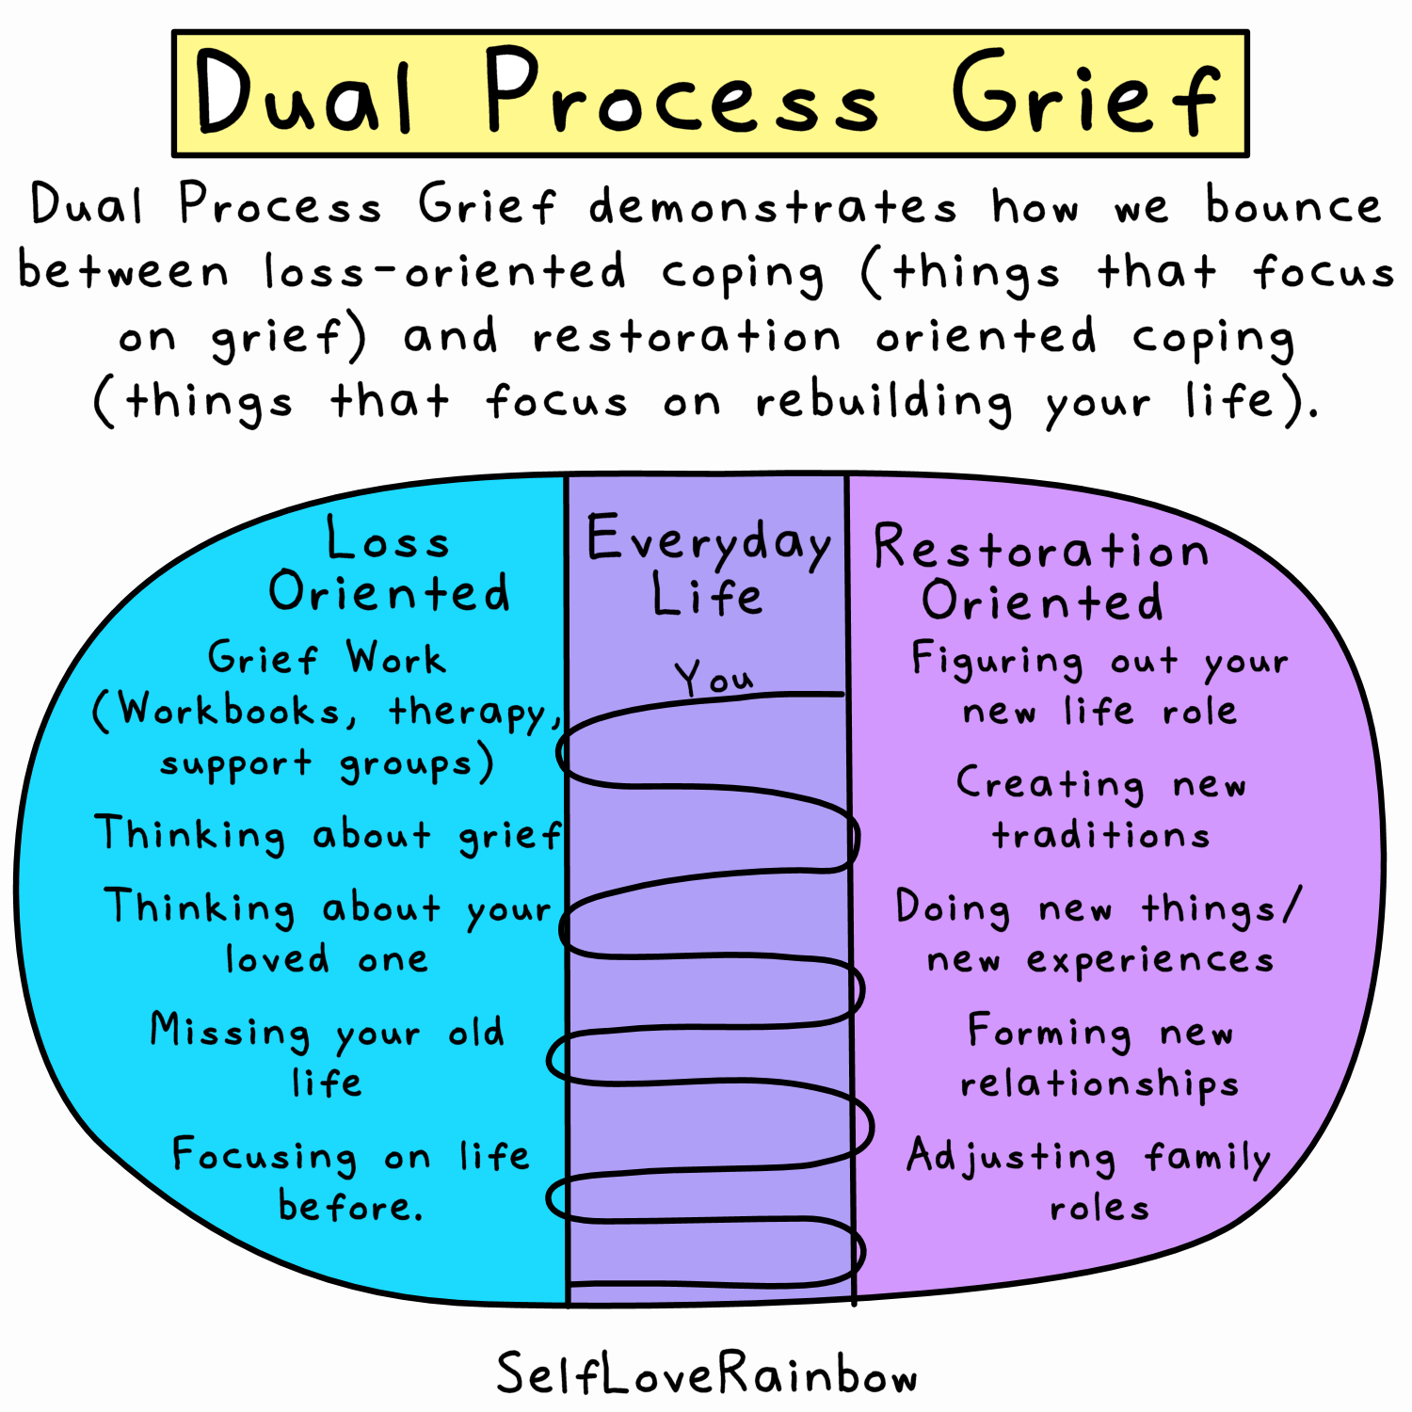
Dual Process Model

Slide 7
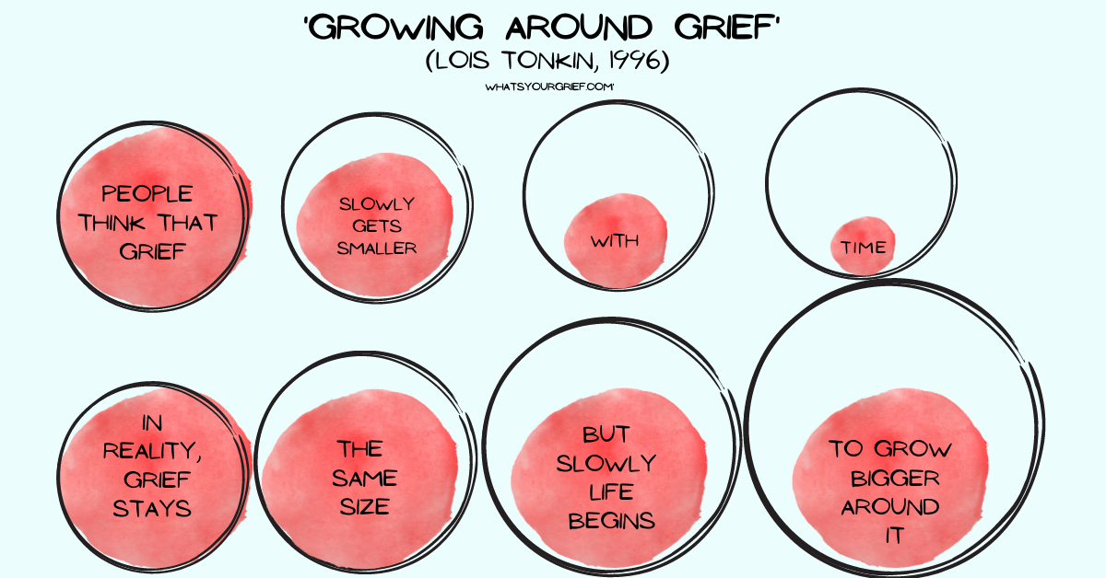
Tonkin Model of Grief

Slide 8
Symptoms of Grief
Sadness
Fear
Guilt
Feelings of vulnerability
Helplessness
Abandonment
Numbness
Anxiety
Depression
Compromised immune system
Mood swings
Social isolation
Altered behaviour – risk taking, etc.

Slide 9
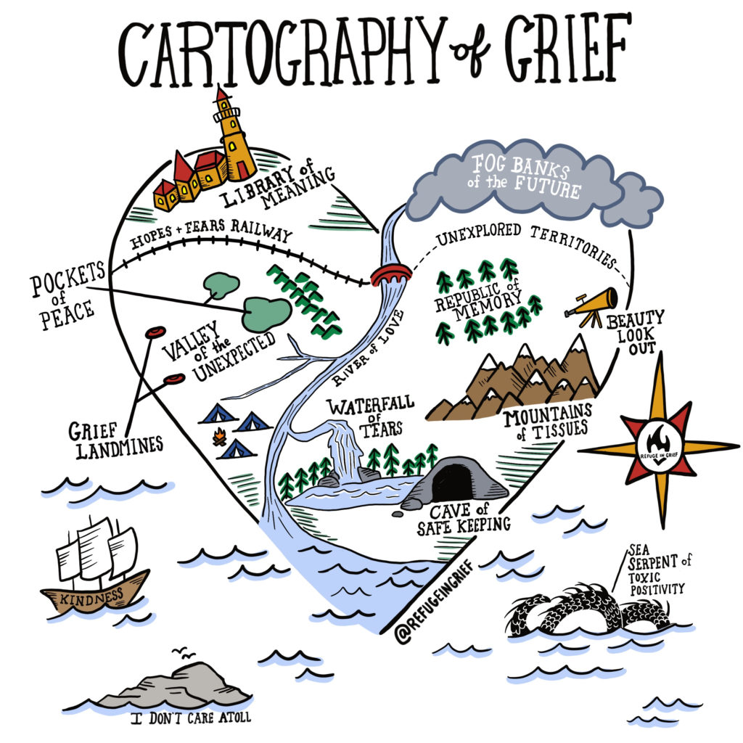
Myths about Grief
Denial, Anger, Bargaining, Depression & Acceptance
Reality
https://www.psycom.net/stages-of-grief
https://refugeingrief.com/2019/02/14/cartography-of-grief/

Slide 10
Myths about Grief
MYTH - All loss is the same.
TRUTH - Each person and their experiences are different.
MYTH - There is a right and a wrong way to grieve.
TRUTH - People grieve according to what is natural for them and for what they need.
MYTH - You only grieve the loss of close friends and family.
TRUTH - From strangers to acquaintances to close family, you can grieve the loss.
MYTH - It is comforting for the bereaved to hear statements like “I understand what you are going through” or “Try your best to be strong.”
TRUTH - Often phrases like “something good can come out of this” are hurtful. They need someone to just be there and listen.

Slide 11
Myths about Grief
MYTH - Expressing intense emotion is a sign they are losing control.
TRUTH - Intense emotions, including that of anger, are often cathartic and necessary to heal.
MYTH - Grief should only last a certain amount of time.
TRUTH - Grief does not have a timeline; “it takes as long as it takes” Grief also does not decline gradually.
MYTH - People are unable to be happy while they grieve or are in denial when they are happy.
TRUTH - Grief comes in waves, so there are high and low moments.
MYTH - A caregiver experiences only grief when their loved one dies.
TRUTH - Sometimes people feel guilt over the death of someone they were a caregiver for because they are now relieved of that responsibility.

Slide 12
Factors that Affect
Grief
Past experience with loss, bereavement, and coping methods
Relationship with the person who is sick or died
Cause of illness/death
Age of the bereaved
Personality (ex. ability to handle change)
Background (cultural, social, ethnic, religious)
Gender roles (ex. men often feel the pressure to keep a “stiff upper lip”)
Additional changes, losses, and stressors (ex. role of the housekeeper no longer filled)
Lack of support or feeling like they are being judged for how they are grieving

Slide 13
What to do if you are grieving
Planning for hard days:
When we’re feeling our worst, it can be hard to think of anything that could help. Use these prompts to think of ideas about what might help and keep this list in a safe place.
If I need help, I can call ________
If I need company, I can call _____
When I’m upset, I can listen to _____
When I need a distraction, I can _____
When I need to feel calmer, I can _______
When grief is intense, I can _____________
Some other activities I can try are_____________
Planning for big days:
Grief can be extra hard before and during important dates like birthdays, anniversaries, holidays, Mother’s Day or Father’s Day, or special events like a graduation or wedding. Planning for these days can help you avoid feeling caught off guard or stressed or missing out on it.

Slide 14
What to do if you are grieving
Which days are important for you? Mark them in your calendar with a message for each day, something like, “go easy on yourself today,” or “take deep breaths,” or maybe something the person used to say to comfort you. Would it help to mark the day before or after, too, so you can prepare or remember to take care of yourself afterwards?
How do you want to spend those days? Some people do what they would normally do, like school or work, so that they can focus on something familiar. Others choose to do something different to mark the occasion, or as a distraction, or for comfort.
Who you would want to see or talk to
A special or important activity you could do, a place to go or visit, something special to wear, special music to listen to,
A movie, show, or game to watch, a book to read, a special meal to cook or eat
Photos or mementos to keep close
Anything else that is meaningful for you
Is there anything you need to do (find, buy, schedule) ahead of time to make these days a bit less stressful? Remember, there is no “right” or “wrong” way to spend these days, just do whatever feels right for you.

Slide 15
What to do if you are grieving
  Create/make something!
  Exercise or movement
  Create a music playlist
  Journal your feelings
  Talk to someone you trust
  Find your calm – grounding techniques, breathing exercises, mindfulness exercises, yoga, meditation, etc.
  write a letter to the person who died
What things help you when you are feeling sad, angry or overwhelmed?
Notes:
Grief recovery method- book, trained facilitators

Slide 16
Complicated Grief
Some hearts are harder to mend and may require a referral to a one-on-one counsellor.
Examples of cases that may need more intensive support:
  Those who experienced multiple deaths
  Violent/traumatic deaths
  Out of order death (death of a child/young person)
  Sudden deaths
  Those who have difficulty accepting the death due to perceived lack of support, a difficult relationship with the dying/deceased, or unfinished business with the dying/deceased.

Slide 17
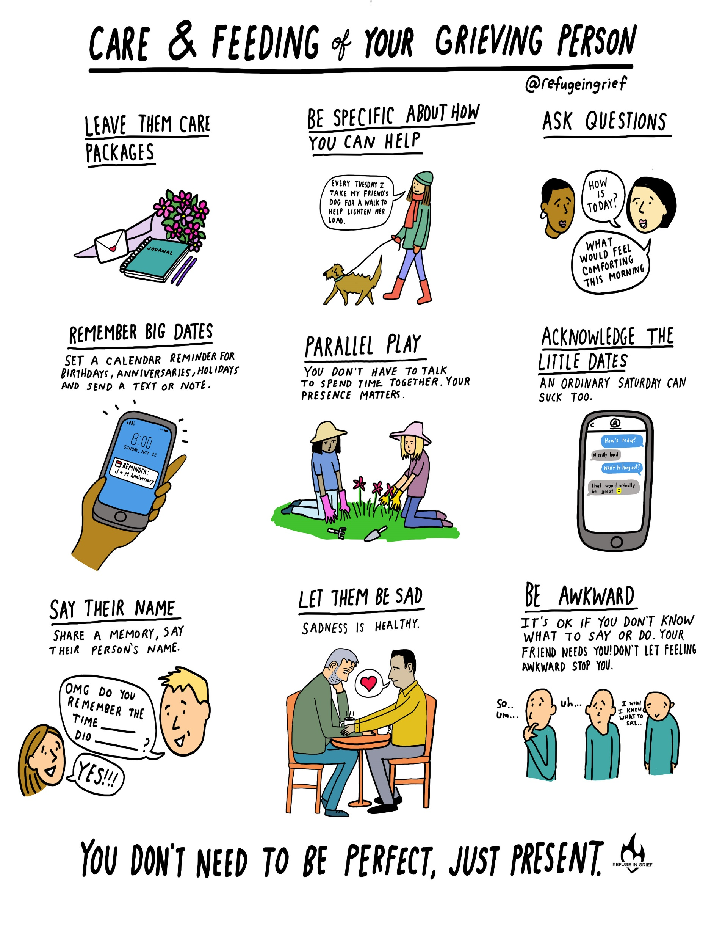
How to help a grieving person?
https://refugeingrief.com/2018/09/09/help-a-friend-comic/
Notes:
Silence is okay. More difficult for the speaker than the listener
Be a peaceful presence
Avoid cliches- He is in a better place etc.
Ask the person what would be helpful- What do you need from me right now?

Slide 18
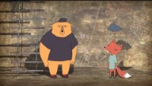
What to say to a grieving person?
Brene Brown- Empathy Versus Sympathy
https://www.youtube.com/watch?v=KZBTYViDPlQ

Slide 19
Hospice Quinte’s
Children’s Grief Group
Monthly grief group for kids age 6 to 11 years who are experiencing grief from an expected death.
Bereaved in the last 3 years, but not earlier than 3 months
This program provides an opportunity for children to express their grief through activity-based programming, connection with peers who have experienced a similar loss and teaches coping strategies.
Easy online referral
Notes:
Hospice Quinte’s 6-week Bereavement Wellness Program is designed to provide support for individuals who are experiencing grief due to the expected death of someone close to them. Groups are offered at select times throughout the year for people 18 years of age and older who have experienced a loss more than three months ago, but no longer than three years ago. You may experience a wait time of several weeks before a group starts.
This program offers a safe and nurturing environment to explore your grief outside of your normal social network, discover coping strategies, share experiences with others in a similar situation, and establish connections to decrease social isolation. The program aims to provide a supportive and transformative experience that honors your unique grief journey and helps you navigate the challenges of loss.
The Bereavement Wellness Program is not appropriate for those who have lost someone in a traumatic way such as suicide, overdose, Medical Assistance in Dying, or the loss of an infant, child, or teenager.

Slide 20
Additional Resources
kidshelpphone.ca – Confidential, anonymous & free, phone & online resources for teens in Canada. Click “I need help now” to be connected with a counsellor right away, or “Resources around me” to find support near you.
good2talk.ca – Good2Talk provides free, confidential support services for post-secondary students in Ontario and Nova Scotia
grievingchildrencanada.org – click on your province or search by city to find grief support services near you.
mindyourmind.ca – Exists in the space where mental health, wellness, engagement and technology meet. Free online resources, blogs, interviews, and more on mental health and illness.
dougy.org – Dougy Center supports grieving children, youth and families. Here are their resources for grieving teens.
help2makesense.org – an online tool by Winston’s Wish, to help young people who have experienced the death of a loved one.
apartofme.app – a game designed to help young people cope with the death of a loved one.
kidsgrief.ca – a free online resource that helps parents support their children when someone in their life is dying or has died.
mygrief.ca – an online resource to help people move through their grief from the comfort of their own home, at their own pace.
childrenandyouthgriefnetwork.com – free resources created by a network of agencies working to increase awareness and community capacity to support grieving people

Slide 21
Additional Resources
Youthab: In-person support groups for ages 16-24 years. Tel: 613-969-0830 ext. 248
whatsyourgrief.com – What’s Your Grief? is a place for grief education, articles, sharing, support & more.
bethere.org – resources to increase mental health literacy and provide youth with the knowledge, skills, and confidence they need to safely support anyone who may be struggling with their mental health.
jack.org – Canadian charity that partners with young leaders in every province and territory to improve youth mental health outcomes in their communities.
suicideprevention.ca – information and resources to reduce the suicide rate and harmful consequences of suicide-related thoughts and behaviours.

Slide 22
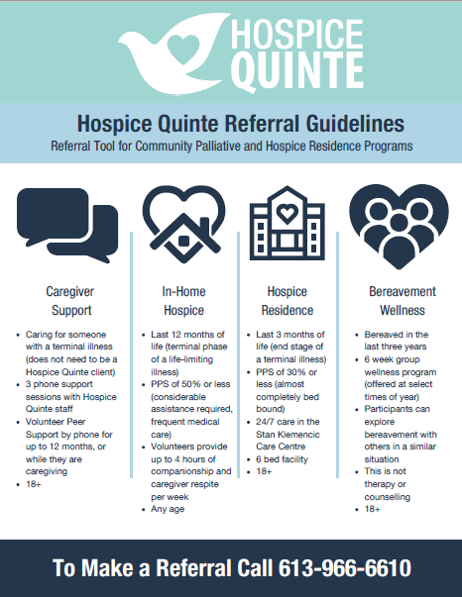

Hospice Quinte

Slide 23
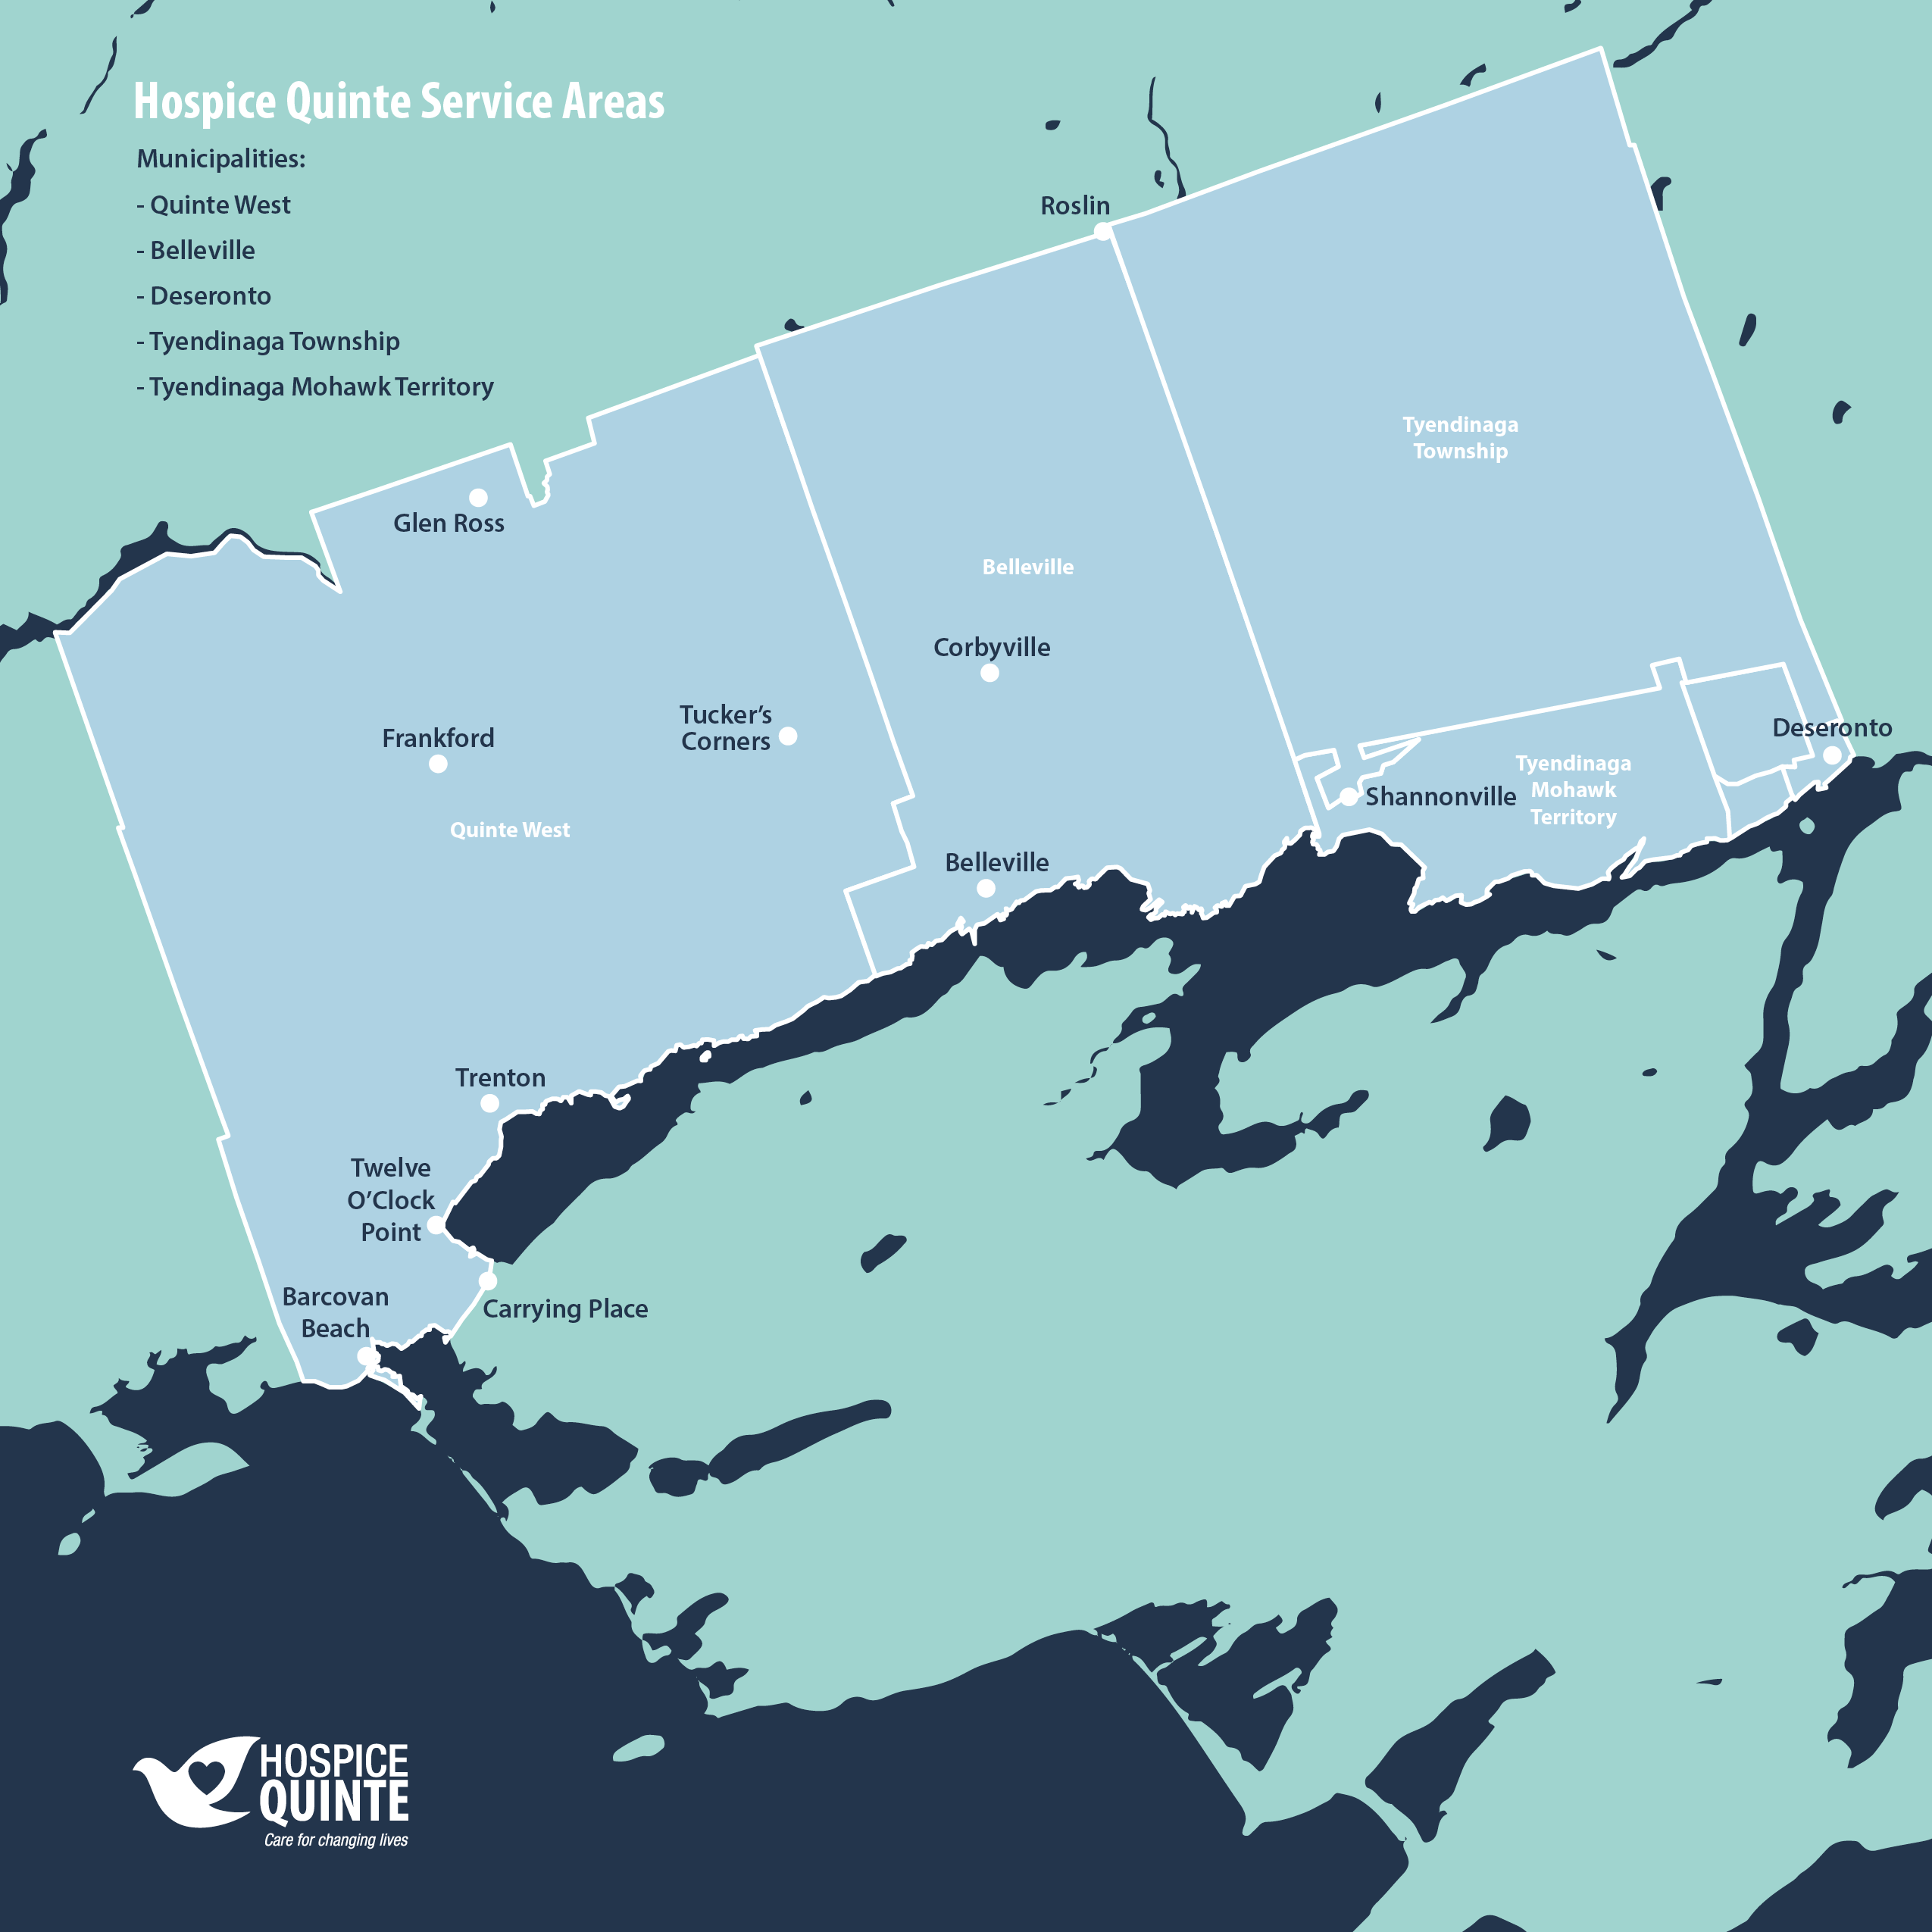
Hospice Quinte Service Area
City of Quinte West
City of Belleville
Town of Deseronto
Tyendinaga Township
Tyendinaga Mohawk Territory

Slide 24
Any Questions?

